Slide 1
Module 4 :Cloud Infrastructure & Platforms in Industry
Cloud Infrastructure & Platforms in Industry

Slide 2
Module 4 : Objectives
After completing this unit you should be able to
Amazon web services
AWS Compute Service
AWS Storage Service
Google Cloud Platform
Google AppEngine: Architecture and Core concepts
Application Life Cycle

Slide 3
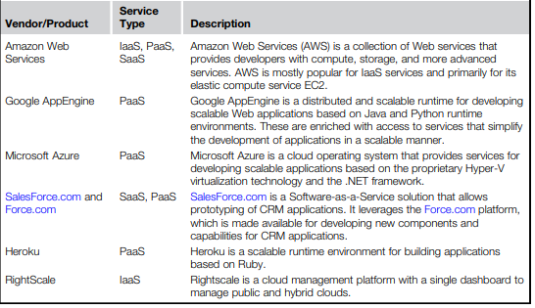
Cloud Computing Offering

Slide 4
Amazon web services
Amazon Web Services (AWS) is a platform that allows the development of flexible applications by providing solutions for elastic infrastructure scalability, messaging, and data storage.
The platform is accessible through SOAP or RESTful Web service interfaces and provides a Web-based console where users can handle administration and monitoring of the resources required, as well as their expenses computed on a pay-as-you-go basis

Slide 5
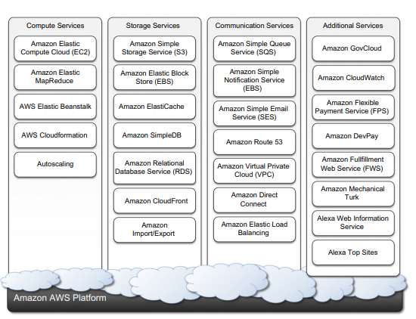
Amazon web services Ecosystem

Slide 6
Compute Services
Amazon EC2 allows deploying servers in the form of virtual machines created as instances of a specific image.
Images come with a preinstalled operating system and a software stack, and instances can be configured for memory, number of processors, and storage.
Users are provided with credentials to remotely access the instance and further configure or install software if needed.

Slide 7
Compute Services - Amazon machine images (AMI)
Amazon Machine Images (AMIs) are templates from which it is possible to create a virtual machine.
They are stored in Amazon S3 and identified by a unique identifier in the form of ami-xxxxxx and a manifest XML file.
An AMI contains a physical file system layout with a predefined operating system installed.
These are specified by the Amazon Ramdisk Image (ARI, id: ari-yyyyyy) and the Amazon Kernel Image (AKI, id: aki-zzzzzz), which are part of the configuration of the template.
AMIs are either created from scratch or “bundled” from existing EC2 instances

Slide 8
Compute Services - EC2 instances
The processing power is expressed in terms of virtual cores and EC2 Compute Units (ECUs).
The ECU is a measure of the computing power of a virtual core; it is used to express a predictable quantity of real CPU power that is allocated to an instance
By using compute units instead of real frequency values, Amazon can change over time the mapping of such units to the underlying real amount of computing power allocated, thus keeping the performance of EC2 instances consistent with standards set by the times.
Over time, the hardware supporting the underlying infrastructure will be replaced by more powerful hardware, and the use of ECUs helps give users a consistent view of the performance offered by EC2 instances.

Slide 9
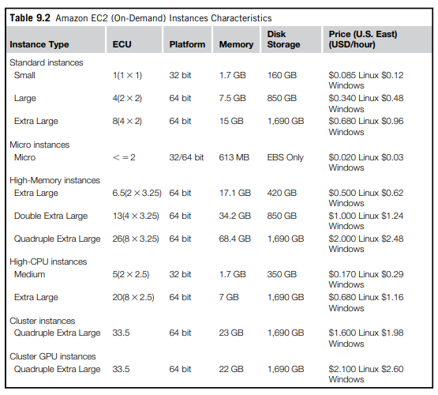
Compute Services - EC2 instances

Slide 10
Compute Services - EC2 instances
EC2 instances are priced hourly according to the category they belong to.
At the beginning of every hour of usage, the user will be charged the cost of the entire hour.
The hourly expense charged for one instance is constant. Instance owners are responsible for providing their own backup strategies, since there is no guarantee that the instance will run for the entire hour.
Another alternative is represented by spot instances. These instances are much more dynamic in terms of pricing and lifetime since they are made available to the user according to the load of EC2 and the availability of resources.

Slide 11
Compute Services - EC2 instances
EC2 instances can be run either by using the command-line tools provided by Amazon, which connects the Amazon Web Service that provides remote access to the EC2 infrastructure, or via the AWS console, which allows the management of other services, such as S3.
By default an EC2 instance is created with the kernel and the disk associated to the AMI.
If the default AKI and ARI are not suitable, EC2 provides capabilities to run EC2 instances by specifying a different AKI and ARI, thus giving flexibility in the creation of instances.

Slide 12
Compute Services - EC2 environment
EC2 instances are executed within a virtual environment, which provides them with the services they require to host applications.
The EC2 environment is in charge of allocating addresses, attaching storage volumes, and configuring security in terms of access control and network connectivity.
By default, instances are created with an internal IP address, which makes them capable of communicating within the EC2 network and accessing the Internet as clients.
It is possible to associate an Elastic IP to each instance, which can then be remapped to a different instance over time
Elastic IPs allow instances running in EC2 to act as servers reachable from the Internet and, since they are not strictly bound to specific instances, to implement failover capabilities

Slide 13
Compute Services - EC2 environment
Instance owners can partially control where to deploy instances. Instead, they have a finer control over the security of the instances as well as their network accessibility.
Instance owners can associate a key pair to one or more instances when these instances are created.
A key pair allows the owner to remotely connect to the instance once this is running and gain root access to it.
Amazon EC2 controls the accessibility of a virtual instance with basic firewall configuration, allowing the specification of source address, port, and protocols (TCP, UDP, ICMP).

Slide 14
Compute Services - Advanced compute services
EC2 instances and AMIs constitute the basic blocks for building an IaaS computing cloud.
On top of these, Amazon Web Services provide more sophisticated services that allow the easy packaging and deploying of applications and a computing platform that supports the execution of MapReduce-based applications
AWS CloudFormation
AWS elastic beanstalk
Amazon elastic MapReduce

Slide 15
Unit 4 : Objectives
After completing this unit you should be able to
Amazon web services
AWS Compute Service
AWS Storage Service
Google Cloud Platform
Google AppEngine: Architecture and Core concepts
Application Life Cycle

Slide 16
Storage Services
AWS provides a collection of services for data storage and information management.
The core service in this area is represented by Amazon Simple Storage Service (S3). This is a distributed object store that allows users to store information in different formats
The core components of S3 are two: buckets and objects. Buckets represent virtual containers in which to store objects; objects represent the content that is actually stored
Objects can also be enriched with metadata that can be used to tag the stored content with additional information

Slide 17
Storage Services - S3 key concepts
AWS provides a collection of services for data storage and information management.
The core service in this area is represented by Amazon Simple Storage Service (S3). This is a distributed object store that allows users to store information in different formats
The core components of S3 are two: buckets and objects. Buckets represent virtual containers in which to store objects; objects represent the content that is actually stored
Objects can also be enriched with metadata that can be used to tag the stored content with additional information

Slide 18
Storage Services - S3 key concepts
It is accessible through a Representational State Transfer (REST) interface, which is quite similar to a distributed file system but which presents some important differences that allow the infrastructure to be highly efficient :
The storage is organized in a two-level hierarchy
Stored objects cannot be manipulated like standard files
Content is not immediately available to users
Requests will occasionally fail
Access to S3 is provided with RESTful Web services. These express all the operations that can be performed on the storage in the form of HTTP requests (GET, PUT, DELETE, HEAD, and POST), which operate differently according to the element they address.

Slide 19
Storage Services - Resource naming
Buckets, objects, and attached metadata are made accessible through a REST interface. Therefore, they are represented by uniform resource identifiers (URIs) under the s3.amazonaws.com domain
Amazon offers three different ways of addressing a bucket:
Canonical form: http://s3.amazonaws.com/bukect_name/
Subdomain form: http://bucketname.s3.amazon.com/
Virtual hosting form: http://bucket-name.com/.
Objects are always referred as resources local to a given bucket. Therefore, they always appear as a part of the resource component of a URI
Canonical form: http://s3.amazonaws.com/bukect_name/object_name
Subdomain form: http://bucket-name/s3.amzonaws.com/object_name
Virtual hosting form: http://bucket-name.com/object_name

Slide 20
Storage Services - Bucket
Except for the ?, which separates the resource path of a URI from the set of parameters passed with the request, all the characters that follow the / after the bucket reference constitute the name of the object
For instance, path separator characters expressed as part of the object name do not have corresponding physical layout within the bucket store
Finally, specific information about a given object, such as its access control policy or the server logging settings defined for a bucket, can be referenced using a specific parameter. More precisely:
Object ACL: http://s3.amazonaws.com/bukect_name/object_name?acl
Bucket server logging: http://s3.amzonaws.com/bucket_name?logging
Object metadata are not directly accessible through a specific URI, but they are manipulated by adding attributes in the request of the URL and are not part of the identifier

Slide 21
Storage Services - S3 Key Concept
Resource Naming
Buckets
Objects and Meta Data
Access Control and Security
Advanced Features

Slide 22
Storage Services - Amazon EBS

Slide 23
Storage Services - Amazon Elasticache
ElastiCache is an implementation of an elastic in-memory cache based on a cluster of EC2 instances.
It provides fast data access from other EC2 instances through a Memcached-compatible protocol so that existing applications based on such technology do not need to be modified and can transparently migrate to ElastiCache
ElastiCache is based on a cluster of EC2 instances running the caching software, which is made available through Web services. An ElastiCache cluster can be dynamically resized according to the demand of the client applications.
ElastiCache nodes are priced according to the EC2 costing model, with a small price difference due to the use of the caching service installed on such instances.
It is possible to choose between different types of instances

Slide 24
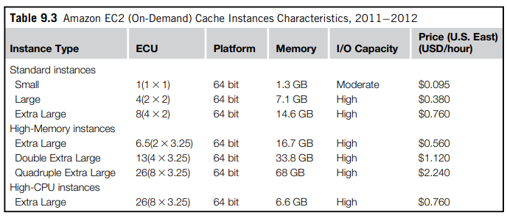
Storage Services - Amazon Elasticache

Slide 25
Storage Services - Structured Storage Solutions
Preconfigured EC2 AMIs.
Amazon RDS
Amazon SimpleDB

Slide 26
Storage Services - Structured Storage Solutions
Amazon RDS
RDS is relational database service that relies on the EC2 infrastructure and is managed by Amazon.
Developers do not have to worry about configuring the storage for high availability, designing failover strategies, or keeping the servers up-to-date with patches.
Moreover, the service provides users with automatic backups, snapshots, point-in-time recoveries, and facilities for implementing replications. These and the common database management services are available through the AWS console or a specific Web service.
Two relational engines are available: MySQL and Oracle
Two key advanced features of RDS are multi-AZ deployment and read replicas.

Slide 27
Storage Services - Structured Storage Solutions
Amazon RDS
The first option provides users with a failover infrastructure for their RDBMS solutions. The high-availability solution is implemented by keeping in standby synchronized copies of the services in different availability zones that are activated if the primary service goes down.
The second option provides users with increased performance for applications that are heavily based on database reads. In this case, Amazon deploys copies of the primary service that are only available for database reads, thus cutting down the response time of the service
The available options and the relative pricing of the service during 20112012 are shown in Table 9.4. The table shows the costing details of the on-demand instances

Slide 28
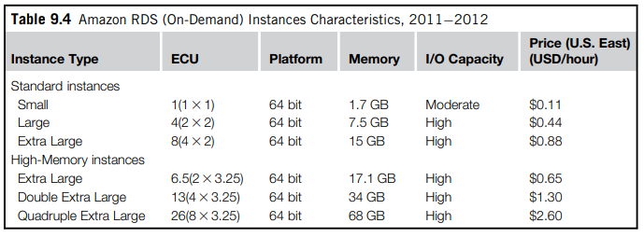
Storage Services - Structured Storage Solutions
Amazon RDS

Slide 29
Storage Services - Structured Storage Solutions
Amazon RDS
With respect to the previous solution, users are not responsible for managing, configuring, and patching the database management software, but these operations are performed by the AWS.
In addition, support for elastic management of servers is simplified. Therefore, this solution is optimal for applications based on the Oracle and MySQL engines, which are migrated on the AWS infrastructure and require a scalable database solution.

Slide 30
Storage Services - Structured Storage Solutions
Amazon SimpleDB
Amazon SimpleDB is a lightweight, highly scalable, and flexible data storage solution for applications that do not require a fully relational model for their data. SimpleDB provides support for semistructured data, the model for which is based on the concept of domains, items, and attributes.
With respect to the relational model, this model provides fewer constraints on the structure of data entries, thus obtaining improved performance in querying large quantities of data.
As happens for Amazon RDS, this service frees AWS users from performing configuration, management, and high-availability design for their data stores.
SimpleDB uses domains as top-level elements to organize a data store. These domains are roughly comparable to tables in the relational model. Unlike tables, they allow items not to have all the same column structure; each item is therefore represented as a collection of attributes expressed in the form of a key-value pair.

Slide 31
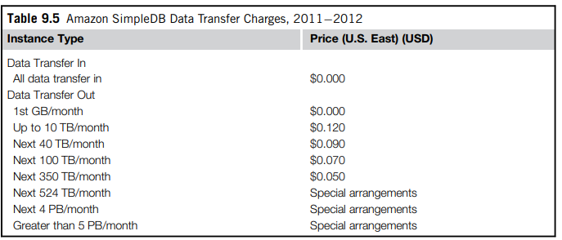
Storage Services - Structured Storage Solutions
Amazon SimpleDB

Slide 32
Storage Services – Amazon Cloud Front
CloudFront is an implementation of a content delivery network on top of the Amazon distributed storage infrastructure.
It leverages a collection of edge servers strategically located around the globe to better serve requests for static and streaming Web content so that the transfer time is reduced as much as possible.
AWS provides users with simple Web service APIs to manage CloudFront.
To make available content through CloudFront, it is necessary to create a distribution. This identifies an origin server, which contains the original version of the content being distributed, and it is referenced by a DNS domain under the Cloudfront.net domain name
The content that can be delivered through CloudFront is static (HTTP and HTTPS) or streaming (Real Time Messaging Protocol, or RMTP). The origin server hosting the original copy of the distributed content can be an S3 bucket, an EC2 instance, or a server external to the Amazon network.

Slide 33
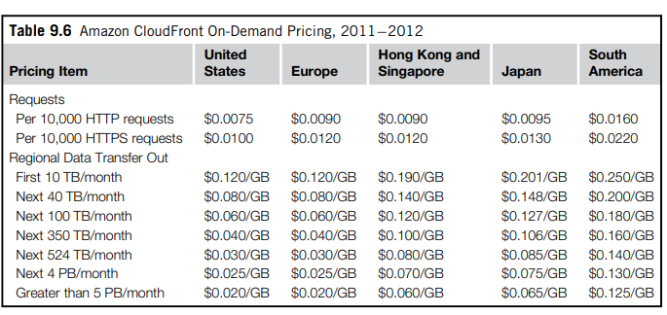
Storage Services – Amazon Cloud Front

Slide 34
Google AppEngine
Google AppEngine is a PaaS implementation that provides services for developing and hosting scalable Web applications.
AppEngine is essentially a distributed and scalable runtime environment that leverages Google’s distributed infrastructure to scale out applications facing a large number of requests by allocating more computing resources to them and balancing the load among them.
The runtime is completed by a collection of services that allow developers to design and implement applications that naturally scale on AppEngine.
Developers can develop applications in Java, Python, and Go, a new programming language developed by Google to simplify the development of Web applications.
Application usage of Google resources and services is metered by AppEngine, which bills users when their applications finish their free quotas.

Slide 35
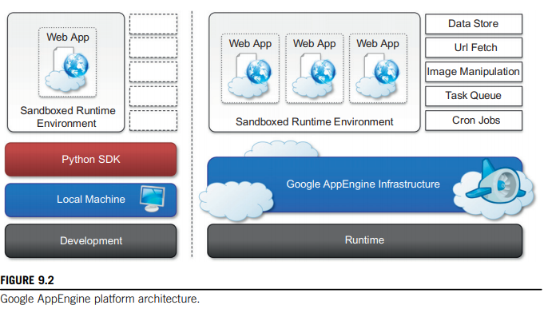
Architecture and core concepts
AppEngine is a platform for developing scalable applications accessible through the Web.
The platform is logically divided into four major components: infrastructure, the runtime environment, the underlying storage, and the set of scalable services that can be used to develop applications

Slide 36
Architecture and core concepts
Infrastructure
AppEngine hosts Web applications, and its primary function is to serve users requests efficiently.
To do so, AppEngine’s infrastructure takes advantage of many servers available within Google datacenters.
For each HTTP request, AppEngine locates the servers hosting the application that processes the request, evaluates their load, and, if necessary, allocates additional resources (i.e., servers) or redirects the request to an existing server.
The infrastructure is also responsible for monitoring application performance and collecting statistics on which the billing is calculated

Slide 37
Architecture and core concepts
Runtime Environment
The runtime environment represents the execution context of applications hosted on AppEngine.
With reference to the AppEngine infrastructure code, which is always active and running, the runtime comes into existence when the request handler starts executing and terminates once the handler has completed.
Sandboxing.
Supported Runtime

Slide 38
Architecture and core concepts
Runtime Environment
Sandboxing
One of the major responsibilities of the runtime environment is to provide the application environment with an isolated and protected context in which it can execute without causing a threat to the server and without being influenced by other applications. In other words, it provides applications
with a sandbox.
AppEngine supports applications that are developed only with managed or interpreted languages, which by design require a runtime for translating their code into executable instructions.
Therefore, sandboxing is achieved by means of modified runtimes for applications that disable some of the common features normally available with their default implementations.

Slide 39
Architecture and core concepts
Runtime Environment
Supported Runtime
Currently, it is possible to develop AppEngine applications using three different languages and related technologies: Java, Python, PHP, Go, and Node.js.

Slide 40
Architecture and core concepts
Storage
AppEngine provides various types of storage, which operate differently depending on the volatility of the data. There are three different levels of storage: in memory-cache, storage for semi-structured data, and long-term storage for static data.
Let us understand DataStore and the use of static file servers.
Static File Server
Web applications are composed of dynamic and static data. Dynamic data are a result of the logic of the application and the interaction with the user.
Static data often are mostly constituted of the components that define the graphical layout of the application (CSS files, plain HTML files, JavaScript files, images, icons, and sound files) or data files.

Slide 41
Architecture and core concepts
Storage
DataStore
DataStore is a service that allows developers to store semi-structured data. The service is designed to scale and optimized to quickly access data.
DataStore can be considered as a large object database in which to store objects that can be retrieved by a specified key.
DataStore provides high-level abstractions that simplify interaction with Bigtable.
DataStore also provides facilities for creating indexes on data and to update data within the context of a transaction. Indexes are used to support and speed up queries.
The implementation of transaction is limited in order to keep the store scalable and fast. AppEngine ensures that the update of a single entity is performed atomically.

Slide 42
Architecture and core concepts
Application Services
Applications hosted on AppEngine take the most from the services made available through the runtime environment.
These services simplify most of the common operations that are performed in Web applications: access to data, account management, integration of external resources, messaging and communication, image manipulation, and asynchronous computation
UrlFetch
MemCache
Mail and Instant Messaging
Account Management
Image Manipulations

Slide 43
Architecture and core concepts
Compute services
AppEngine offers additional services such as Task Queues and Cron Jobs that simplify the execution of computations that are off-bandwidth or those that cannot be performed within the timeframe of the Web request.
Task queues
Task Queues allow applications to submit a task for a later execution.
This service is particularly useful for long computations that cannot be completed within the maximum response time of a request handler.
The service allows users to have up to 10 queues that can execute tasks at a configurable rate
Cron jobs
In this case, it is possible to schedule the required operation at the desired time by using the Cron Jobs service.
This service operates similarly to Task Queues but invokes the request handler specified in the task at a given time and does not reexecute the task in case of failure.

Slide 44
Application Lifecycle
AppEngine provides support for almost all the phases characterizing the life cycle of an application: testing and development, deployment, and monitoring.
The SDKs released by Google provide developers with most of the functionalities required by these tasks. Currently there are two SDKs available for development: Java SDK and Python SDK…
Application Development and Testing
Java SDK
Python SDK

Slide 45
Application Lifecycle
Application Deployment and Management
Once the application has been developed and tested, it can be deployed on AppEngine with a simple click or command-line tool.
Before performing such task, it is necessary to create an application identifier, which will be used to locate the application from the Web browser by typing the address http:// , application-id.appspot.com.
Alternatively, it is also possible to map the application with a registered DNS domain name.
This is particularly useful for commercial development, where users want to make the application available through a more appropriate name

Slide 46
Application Lifecycle
Application Deployment and Management
An application identifier is mandatory because it allows unique identification of the application while it’s interacting with AppEngine.
Developers use an app identifier to upload and update applications. Besides being unique, it also needs to be compliant to the rules that are enforced for domain names.
It is possible to register an application identifier by logging into AppEngine and selecting the “Create application” option.
Once an application identifier has been created, it is possible to deploy an application on AppEngine. This task can be done using either the respective development environment (GoogleAppEngineLauncher and Google AppEngine plug-in) or the command-line tools. Once the application is uploaded, nothing else needs to be done to make it available. AppEngine will take care of everything. Developers can then manage the application by using the administrative console. This is the primary tool used for application monitoring and provides users with insight into resource usage (CPU, bandwidth) and services and other useful counters. It is also possible to manage multiple versions of a single application, select the one available for the release, and manage its billing-related issues

Slide 47
Application Lifecycle
Application Deployment and Management
Once an application identifier has been created, it is possible to deploy an application on AppEngine.
This task can be done using either the respective development environment (GoogleAppEngineLauncher and Google AppEngine plug-in) or the command-line tools.
Once the application is uploaded, nothing else needs to be done to make it available. AppEngine will take care of everything. Developers can then manage the application by using the administrative console.
This is the primary tool used for application monitoring and provides users with insight into resource usage (CPU, bandwidth) and services and other useful counters. It is also possible to manage multiple versions of a single application, select the one available for the release, and manage its billing-related issues

Slide 48
Cost Model
AppEngine provides a free service with limited quotas that get reset every 24 hours. Once the application has been tested and tuned for AppEngine, it is possible to set up a billing account and obtain more allowance and be charged on a pay-per-use basis.
An application is measured against billable quotas, fixed quotas, and per-minute quotas. Google AppEngine uses these quotas to ensure that users do not spend more than the allocated budget and that applications run without being influenced by each other from a performance point of view
Once an application reaches the quota for a given resource, the resource is depleted and will not be available to the application until the quota is replenished. Once a resource is depleted, subsequent requests to that resource will generate an error or an exception
Resources and services quotas are organized into free default quotas and billing-enabled default quotas. For these two categories, a daily limit and a maximum rate are defined.

Slide 49
Observations
AppEngine, a framework for developing scalable Web applications, leverages Google’s infrastructure. The core components of the service are a scalable and sandboxed runtime environment for executing applications and a collection of services that implement most of the common features required for Web development and that help developers build applications that are easy to scale.
One of the characteristic elements of AppEngine is the use of simple interfaces that allow applications to perform specific operations that are optimized and designed to scale. Building on top of these blocks, developers can build applications and let AppEngine scale them out when needed.

Slide 50
Observations
With respect to the traditional approach to Web development, the implementation of rich and powerful applications requires a change of perspective and more effort.
Developers have to become familiar with the capabilities of AppEngine and implement the required features in a way that conforms with the AppEngine application model

Slide 51
References
Rajkumar Buyya, Christian Vecchiola, and Thamarai Selvi, Mastering Cloud Computing, McGraw Hill, ISBN-13: 978-1-25-902995-0, New Delhi, India, 2013.
Chapter 9

